Slide 1
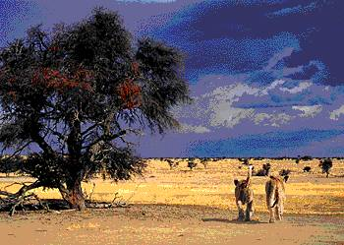
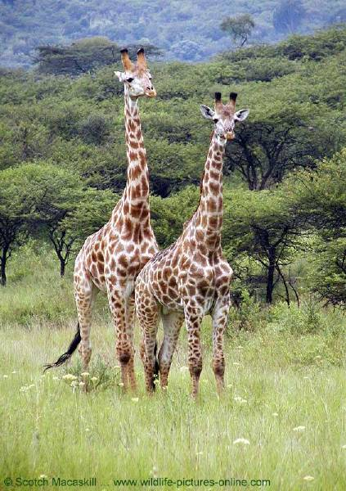
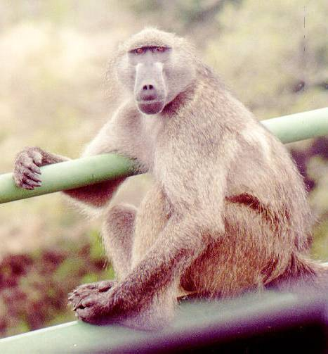
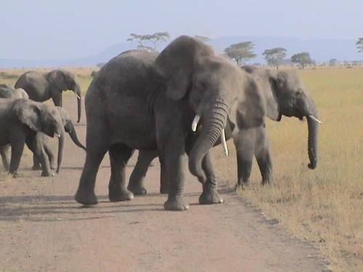
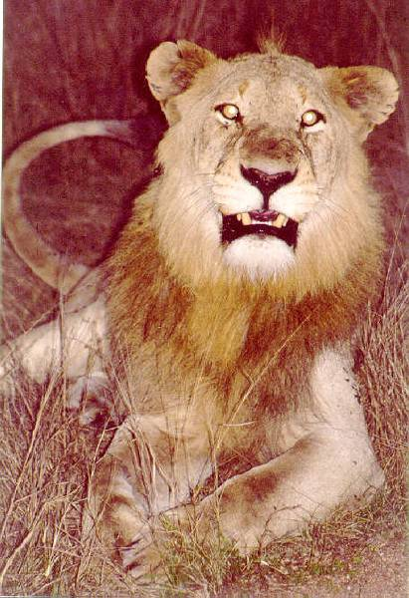
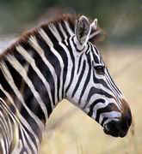
Ancient Africa PowerPoint 1

Slide 2
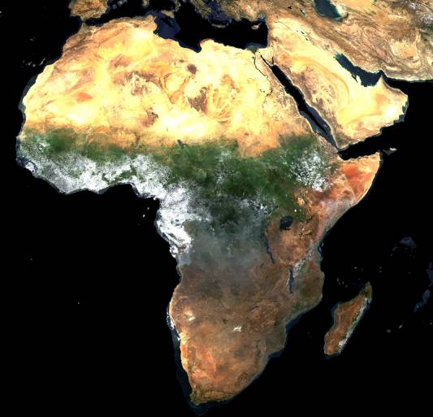
A Satellite View
What feature is this? >>>
What feature is this ? >>>
(green area)

Slide 3
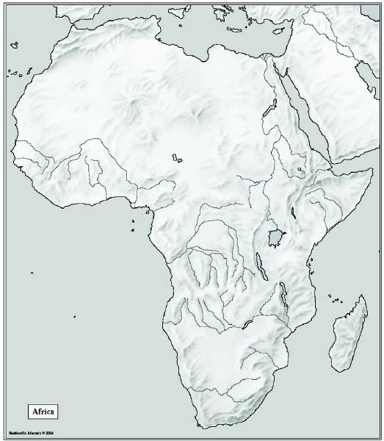
Atlas Mts.
Mediterranean Sea
Libyan Desert
The
Complete
Topography
Of
AFRICA
Tropic of Cancer 20° N
Sahara Desert
Red Sea
Sahel
Nile River
Niger River
L. Chad-->
Great Rift Valley
<--Gulf of Aden
L. Albert-->
Equator 0°
Congo River
Δ Mt. Kenya
L. Victoria
Δ Mt. Kilimanjaro
L. Tanganyika->
Indian Ocean
Ruwenzori Mts.
Atlantic Ocean
Zambezi River
Namib Desert
Kalahari Desert
Tropic of Capricorn 20° S
Limpopo River
Orange River
Drajensburg Mts.
Pacific Ocean

Slide 4
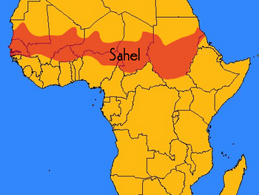
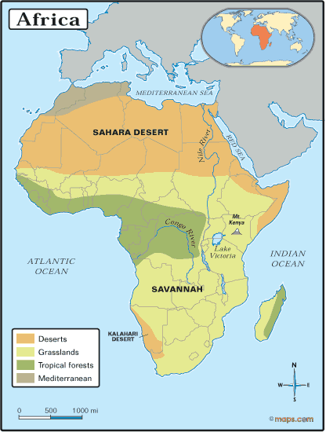
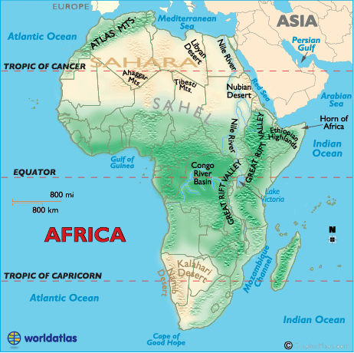
Vegetation Zones

Slide 5
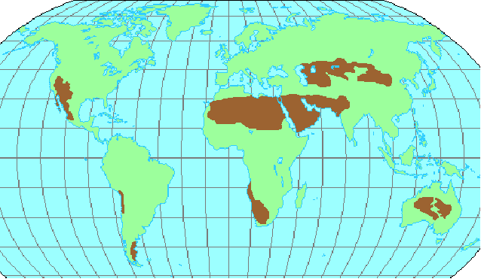
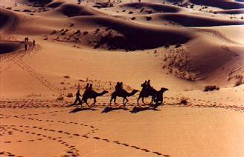
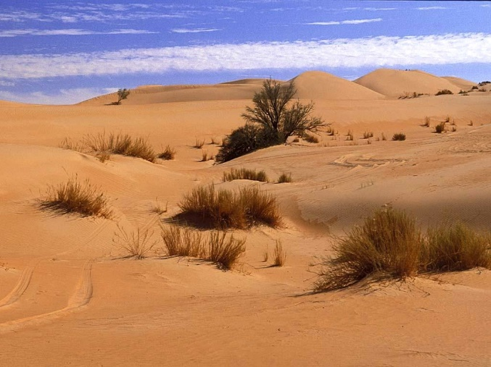
The Sahara Desert
The Sahara Desert is the largest desert in the world.
It is so large it could hold the US within its boundaries.
It covers 25% of the African Continent

Slide 6
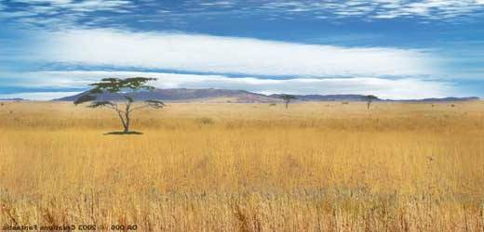
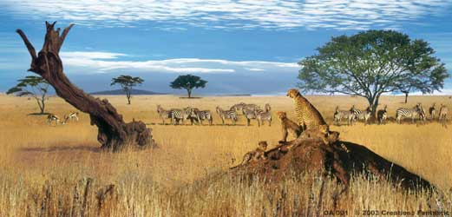
The African Savanna:
13 million square miles
Grassy Plains
Home to more large animals than anywhere else on Earth

Slide 7
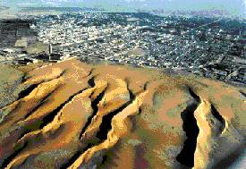
Desertification
The ever expanding boundaries of the desert due to weather patterns – like drought – and due to humans overgrazing their animals, removing native vegetation for planting – all of which destroys the topsoil.

Slide 8
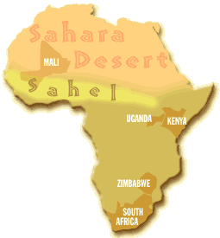
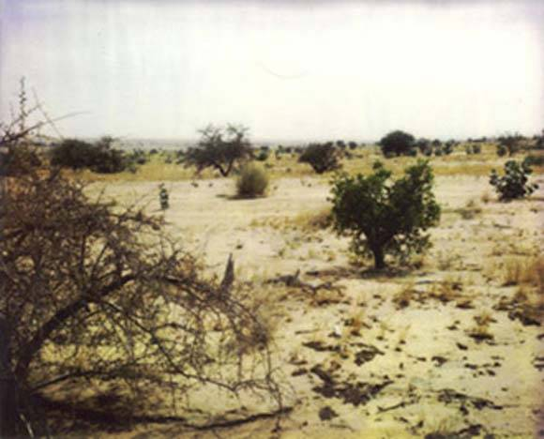
The Sahel
It literally means “Shore”
It is the zone of transition in Africa between the Sahara to the north and the Savanna to the south.
The Sahel is dynamic – which means that it moves as desertification expands the desert.
(Static would mean that it is unchanging)

Slide 9
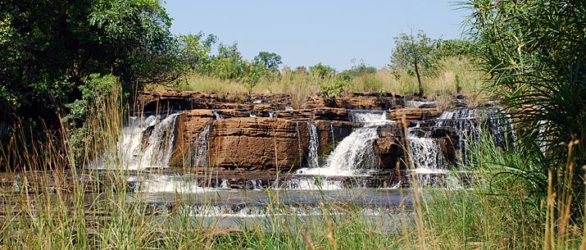
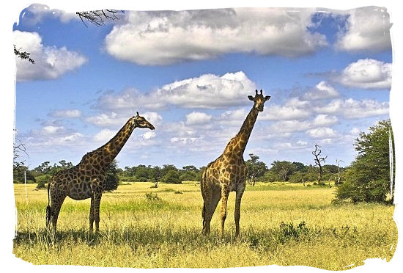
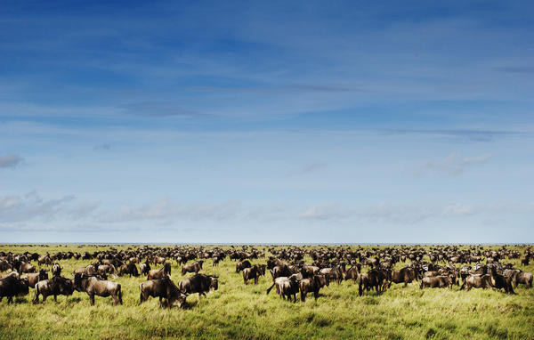
5500 BC Sahara was area of rich grasslands, savanna with plenty of water
Around 2500 BC the land slowly dried out –turning into desert led to migrations , people & animals

Slide 10
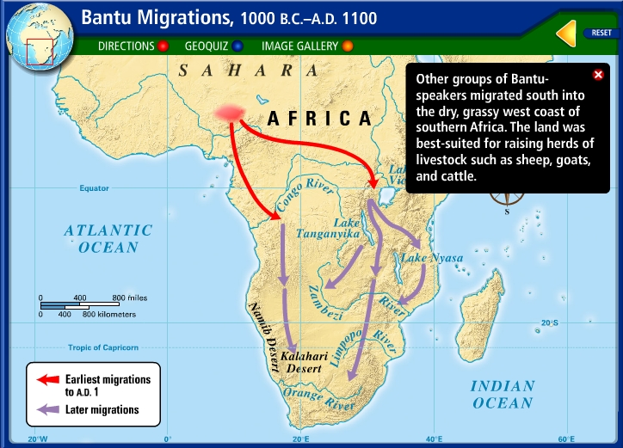
Bantu Migrations
Migrate-
to move from one place to settle in another
Due to desertification –– the Bantu people were forced to move further and further south
One of the largest migrations that has ever taken place
As Bantu speaking Africans spread across the region their language and customs also spread

Slide 11
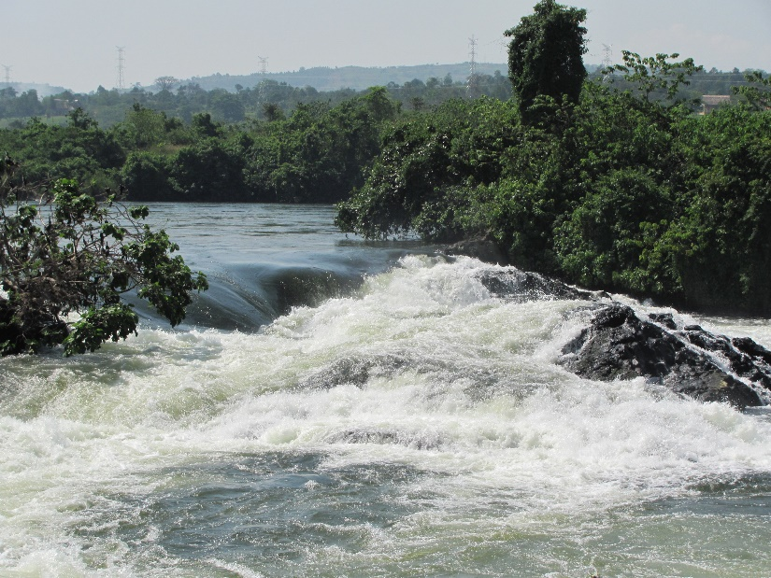
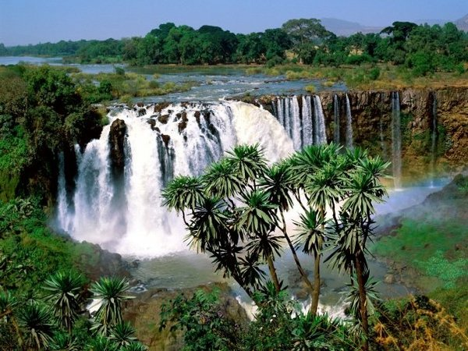
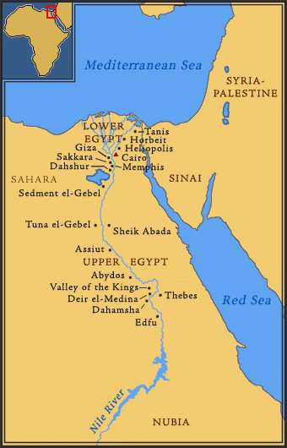
Cataracts are areas of white water rapids as well as areas of steep waterfalls.
The Nile has 6 cataracts
The Lower Nile is north (at the top) and the Upper Nile is south (at the bottom)
This is because the Nile runs from south to north and drains into the Mediterranean Sea.

Slide 12
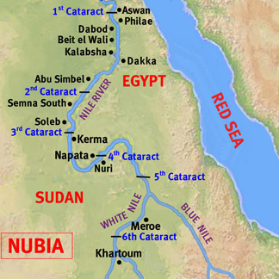
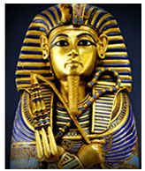
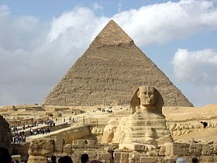
In ancient times, Egypt ruled on the Nile River, between the delta, and the first cataract, some six hundred miles due south of the main exit point of the Nile into the Mediterranean
The cataracts helped to guard Egypt from invaders, but, they also made trade difficult up and down the Nile.
While further upstream (to the south), the land was controlled by the ancient Kingdom of Kush

Slide 13
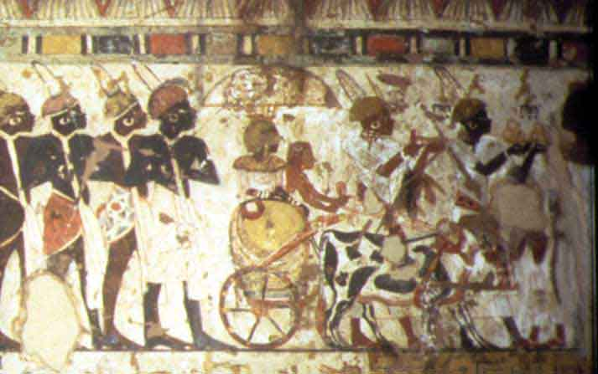
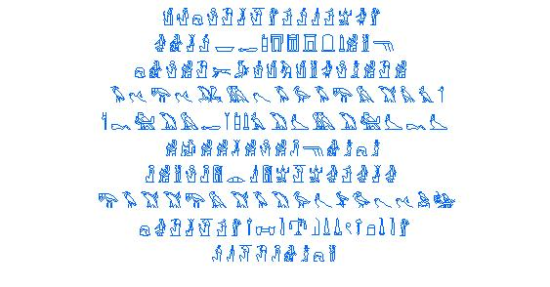
Ancient Kingdom – Nubia / Kush
2700 BC – southern banks of Nile (the upper Nile)
Ancient Nubia was fertile due to annual flooding. ➢ It was rich in valuable minerals that contributed to its wealth. ✓ Gold. ✓ Copper. ✓ Stone.
They had their own system of writing / never deciphered

Slide 14
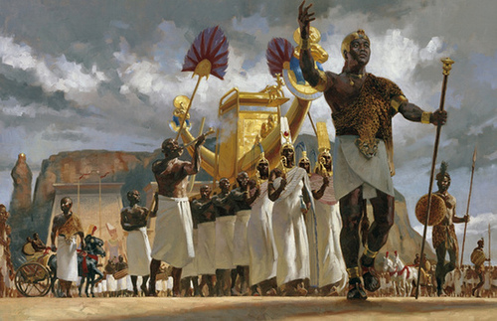
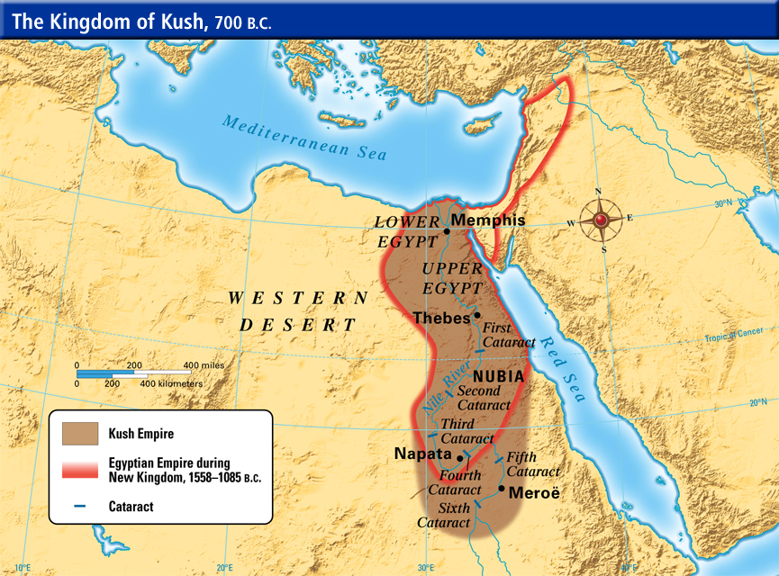
Greatly influenced by Egypt:
Adopted many Egyptian traditions
Warfare between Egypt and Kush was common
The Kushites would later take over Egypt from 760 to 656 BC

Slide 15
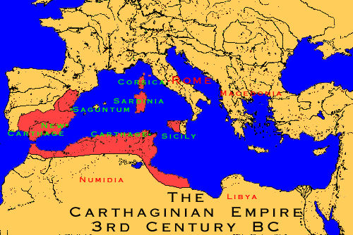
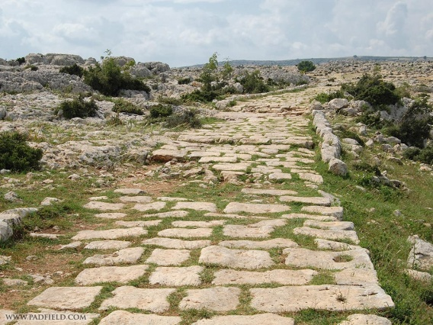
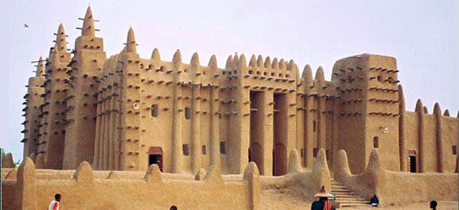
Phoenicians Build Carthage
800 BC – 146 BC Great North African trading empire
Fought w/Rome over trade / Punic Wars
Rome burnt Carthage to the ground
Romans ruled N Africa
Built roads, dams, aqueducts
Brought Christianity
Islam spreads to Africa
690s Muslim Arabs conquer N Africa
Islam replaced Christianity
Arabic replaced Latin

